Slide 1
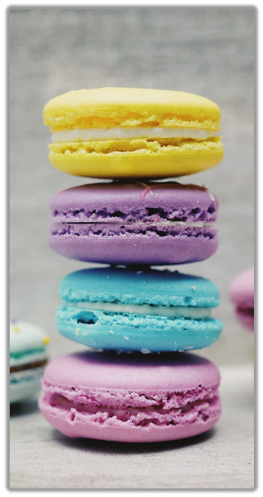
Stack

Slide 2
Introduction
“A Stack is a special kind of list in which all insertions and deletions take place at one end, called the Top”
Other Names
Pushdown List
Last In First Out (LIFO)
Notes:
But NO constraints on HOW the problem is solved

Slide 3
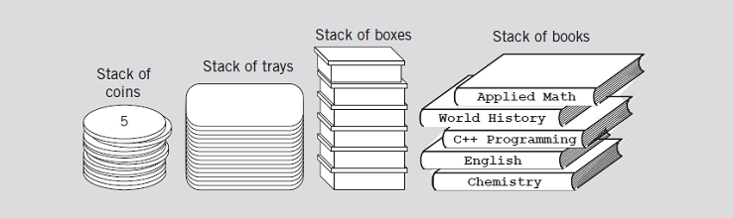
Examples of Stacks
Stack of Books
Stack of Dishes
Various examples of stacks

Slide 4
Common Operations on Stacks
TOP(): Return the element at the top of stack S.
POP(): Remove the top element of the stack.
PUSH(S): Insert the element x at the top of the stack.
ISEMPTY(): To check if stack is empty or not
ClearStack();

Slide 5
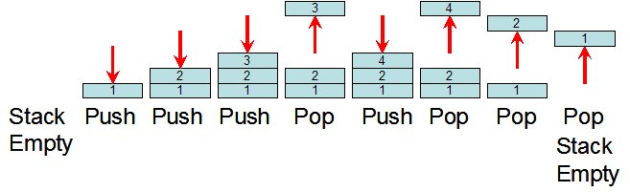
Push and Pop operations of Stack

Slide 6
Example: Function Call Stack
main( ) {
  cout<< "\nI am in main";
  italy( ) ;
  cout<< "\nI am finally back in main";
}
void italy( ) {
  cout<< "\nI am in italy";
  brazil( );
  cout<< "\nI am back in italy";
}
void brazil( ) {
  cout<< "\nI am in brazil" ;
  argentina( ) ;
}
void argentina( ) {
  cout<<"\nI am in argentina";
}
brazil()
italy()
main()
Function Call Stack

Slide 7
Static and Dynamic Stacks
There are two kinds of stack data structure
  a) static, i.e. they have a fixed size, and are implemented as arrays.
  b) dynamic, i.e. they grow in size as needed, and implemented as linked lists

Slide 8
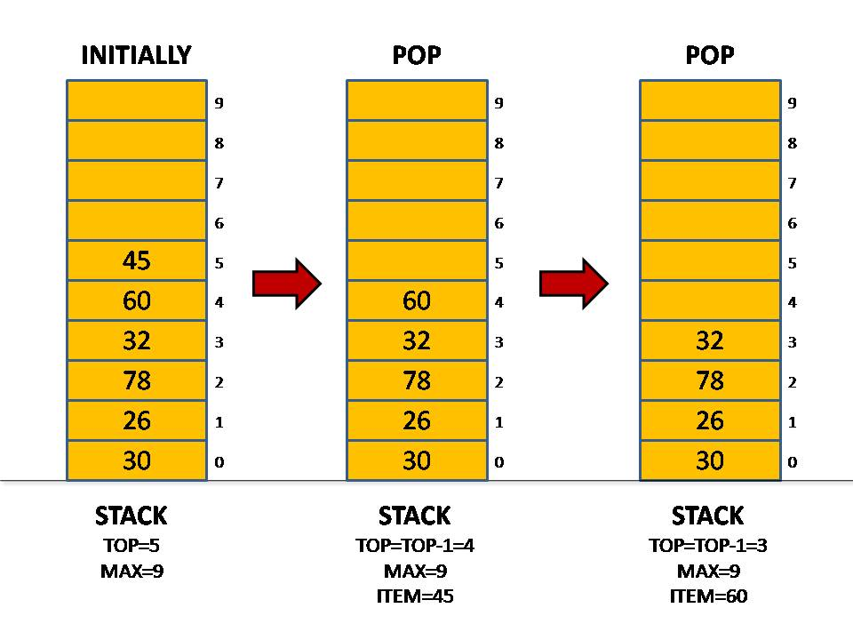
Array implementation

Slide 9
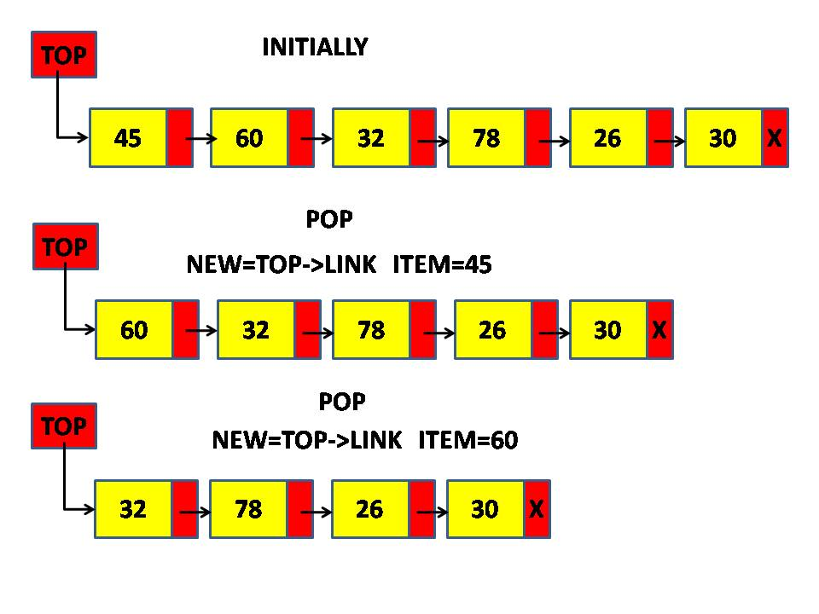
A Linked-List Implementation of Stacks
Stack can expand or shrink with each PUSH or POP operation.
PUSH and POP operate only on the header cell and the first cell on the list.

Slide 10
Linked List Implementation of Stack
class Stack
{
struct node
{
int data;
node *next;
};
node *top;
int size;
public:
Stack(void) // Constructor
{ top = NULL; size=0; }
void Push(int newelement);
void Pop(void);
int Top();
bool IsEmpty();
};

Slide 11
void Stack::Push(int newelement)
{
node *newptr;
newptr=new node;
newptr->data=newelement;
newptr->next=top;
top=newptr;
size++;
}
void Stack::Pop(void)
{
if (IsEmpty()) { cout<<“underflow error”; return;}
tempptr=top;
top=top->next;
delete tempptr;
size--;
}

Slide 12
bool Stack::IsEmpty()
{
if (top==NULL) return true;
else
return false;
}
Int Stack::Top()
{
return top->info;
}

Slide 13
Stack Templates
The stack class so far work with integers only. A stack template can be used to work with any data type.

Slide 14
Applications of Stack
Mohammad Shahid Qureshi

Slide 15
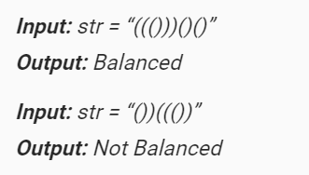
Checking for balanced parentheses (only round pranthesis )
Solution:
  Using a counter can check for balanced pranthesis
  Increment when ‘(’ , decrement when ‘)’

Slide 16
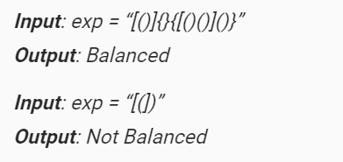
Checking for balanced paranthesis
Solution:
  Counter option will not work over here
  Lets see another solution
Reference: https://www.geeksforgeeks.org/check-for-balanced-parentheses-in-an-expression/

Slide 17
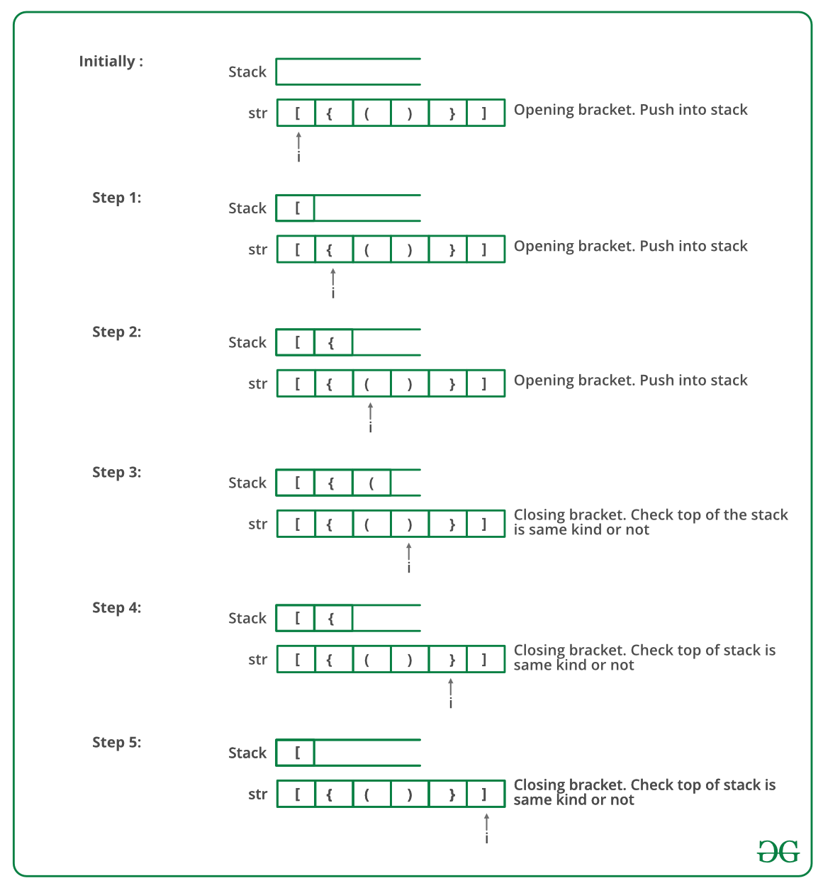

Slide 18
Reference
Chap7, DS Malik
Section 2.3 of 2nd Ed. of “Data Structures using C and C++” by Tanenbaum

